Slide 1
Music Listening as Indicator of Depression Risk (Static and Dynamic)
Depression is classified as a mood disorder. It may be described as feelings of sadness, loss, or anger that interfere with a person’s everyday activities.
Hypothesis :individuals at-risk for depression may engage in repetitive music listening **

Slide 2
Objective
Music as potential indicators for depression risk
Considering session as a period of continuous listening activity, with a subsequent session occurring after an inactivity of at least two hours
We take static and dynamic listening habits.

Slide 3
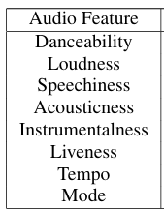
Dataset
Spotify listening history dataset
Spotify user dataset with their:
music listening history with audio features
K10 score
Valence-arousal score
K10: Score on the Kessler Psychological Distress Scale, a measure of psychological distress.
Data of individual consist of :endTime , artistName , trackName , msPlayed

Slide 4
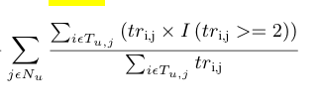

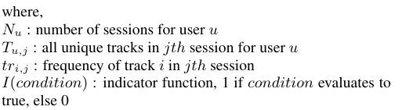
Proposed analysis
1)Songs listened within 2 hours are taken in single session
2)Dynamic RI = (repetitiveness index )
3)Static RI =

Slide 5
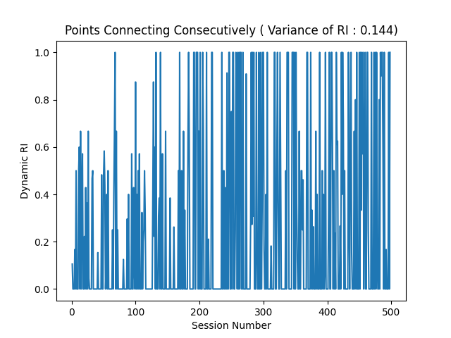
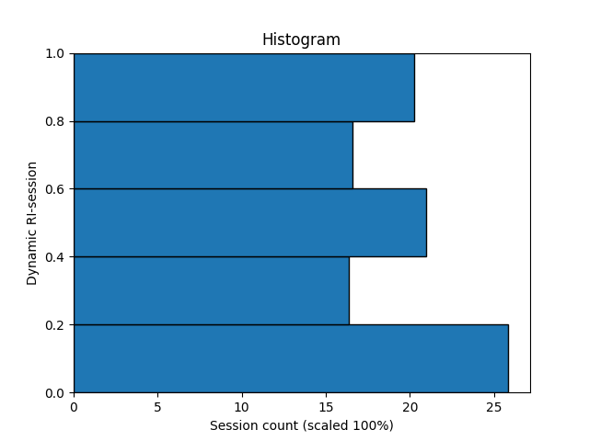
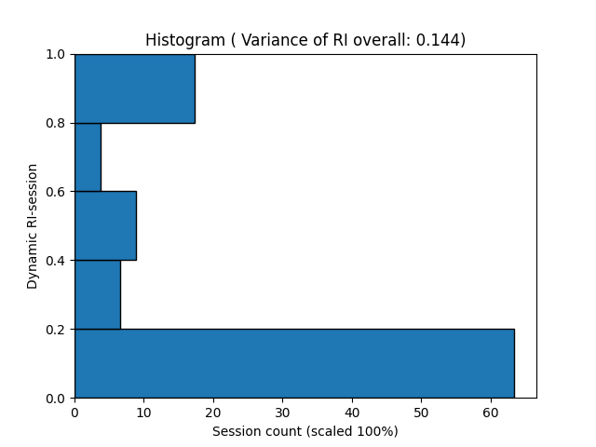
Mid eval’s
Grouped data into sessions
Found dynamic RI and static RI
k10>29 :At Risk k10<29 :No Risk

Slide 6
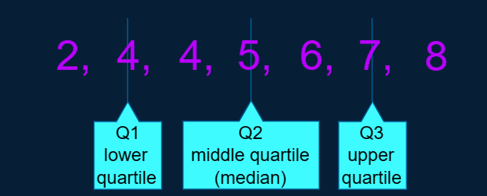
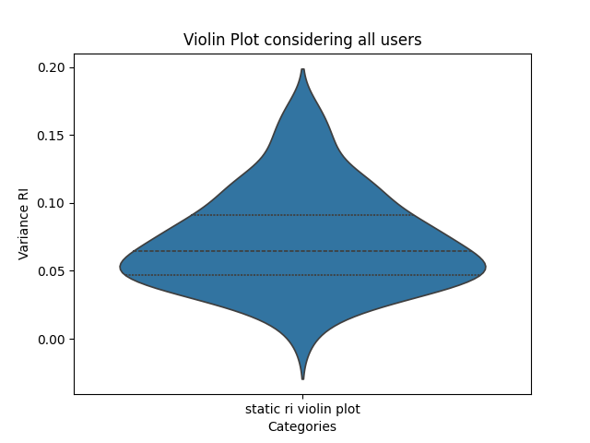
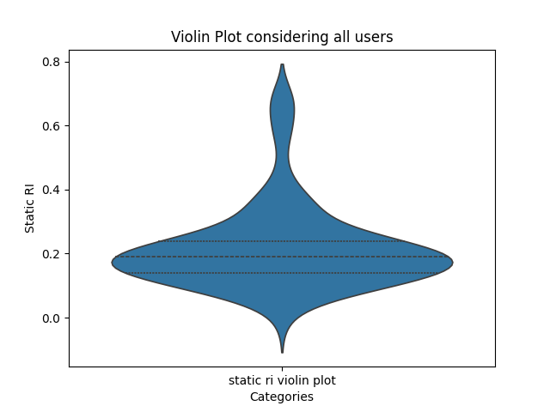
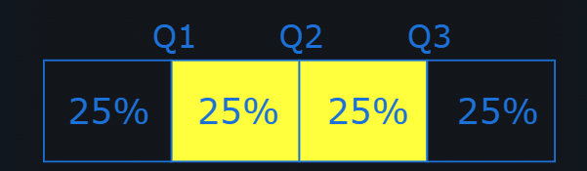
Working on this data

Slide 7
Looking at static session
Additionally with K10
Age: Age of the individual.
Healthy : reflect positive musical experiences that contribute to well-being.(ex music for relaxation, enjoyment, or social connection.)
Unhealthy : highlight negative musical experiences that may intensify negative mood(ex. music to dwell on negative emotions or reinforce distressing thoughts)
SWLS: Satisfaction with Life Scale, a measure of life satisfaction.
SSQ-Family: Social Support Questionnaire - Family, a measure of perceived social support.
SSQ-Friends: Social Support Questionnaire - Friends, a measure of perceived social support.

Slide 8
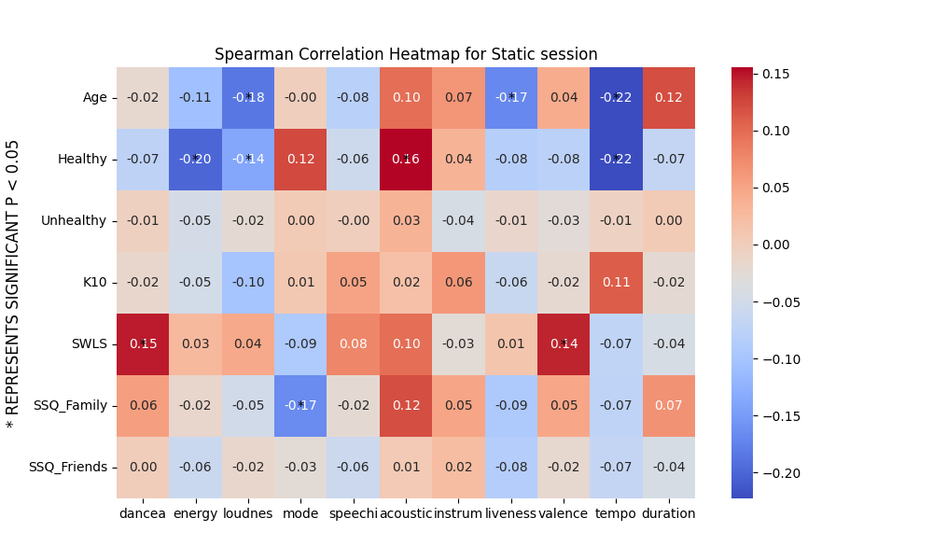

Slide 9
Inference 1
Significant –ve correlation between age and loudness, liveness, tempo
Significant –ve correlation between healthy score and energy(arousal), loudness, tempo
Significant +ve correlation between healthy score and acousticness
Significant +ve correlation SWLS and daceability ,valence
Significant –ve correlation SSQ_Family and mode

Slide 10
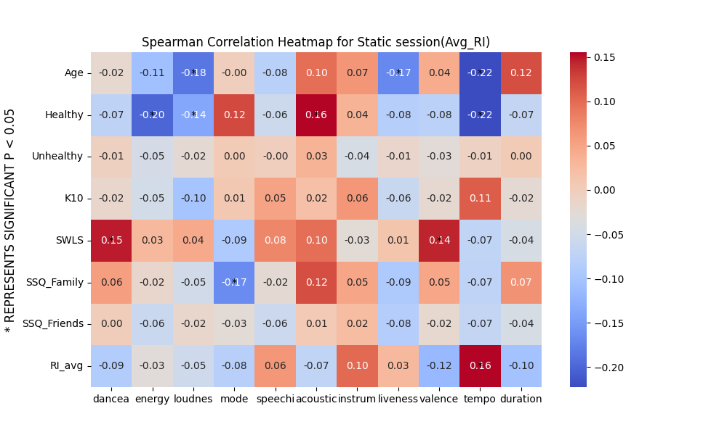

Slide 11
Inference 2
Significant +ve correlation between Static RI and tempo(measured in Beats per minute)

Slide 12
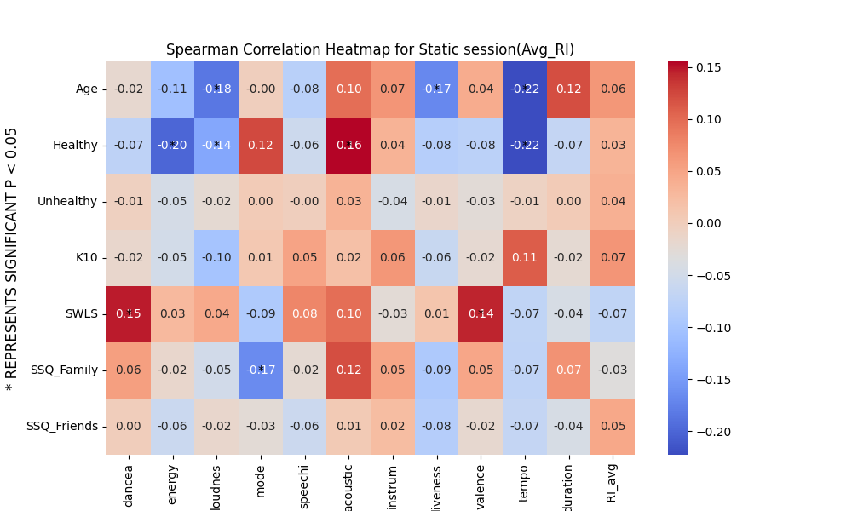

Slide 13
Inference 3
+ve correlation between Static RI and K10 which was expected !
The positive association between Repetitiveness Index and K10 reflects the ruminative coping style which is characteristic of individuals at-risk for depression which may result in intensifying their negative moods

Slide 14
Valence-arousal
Spotify APT provided for track:
Energy: (taken as arousal in paper) :
Energy represents a perceptual measure of intensity and activity . Typically, energetic tracks feel fast, loud, and noisy. For example, death metal has high energy.
Valence:
A describes the musical positiveness conveyed by a track. Tracks with high valence sound more positive (e.g. happy, cheerful, euphoric), while tracks with low valence sound more negative (e.g. sad, depressed, angry).

Slide 15
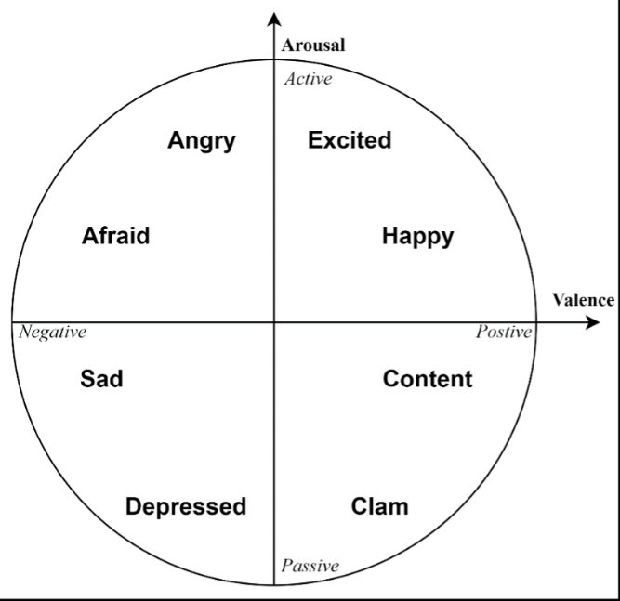
For each quadrant we calculated a quadrant prevalance score (QPS) which is calculated as the proportion of tracks in the respective quadrants
And mapped with k10 of users

Slide 16
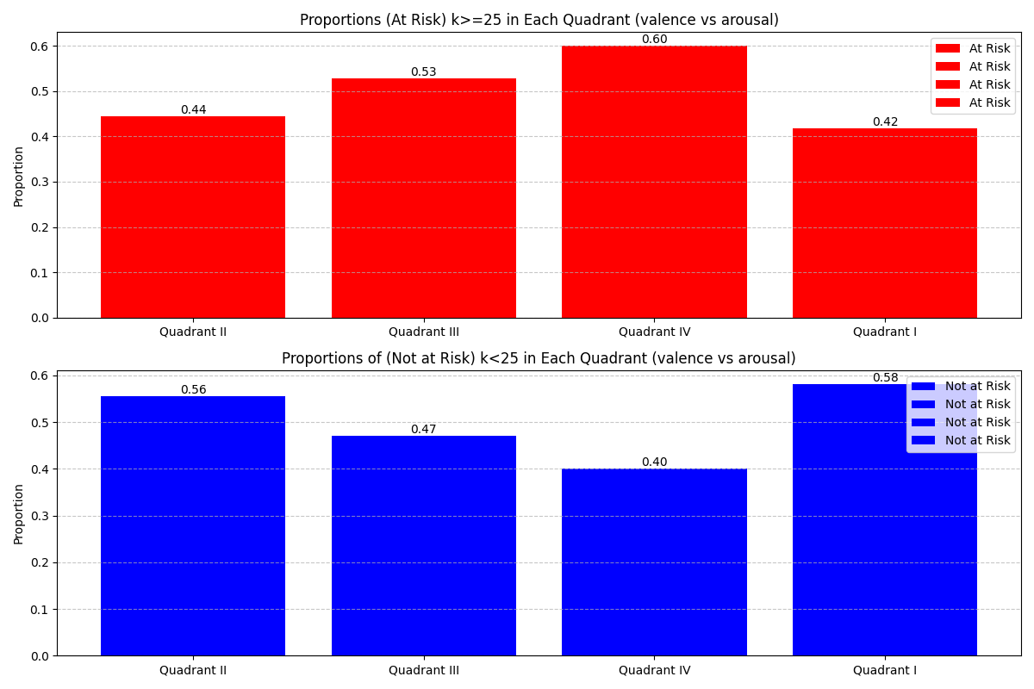

Slide 17
Inference
Third and fourth quadrant has more users at risk of depression, signifying depressed people tend to listen songs of low arousal.
Individuals with high K10 scores are characterized by states that are high in anxiety and arousal. When using music as a coping mechanism, a natural choice may be to listen to music that is low on arousal owing to their already heightened physiologically aroused states.

Slide 18
Dynamic Measures Computation
A person with high instability implies higher fluctuations in music consumption with respect to the features/emotions
Since, instability has been found to have mathematical dependency on the other two measures, that is, it is directly proportional to variability and has inverse relation with inertia.
Therefore ,I restrict analyses to computing only variability and inertia. These two dynamic measures were calculated for all the session-based acoustic features.
Variability calculated as standard deviation of scores across sessions.
Inertia is calculated as the autocorrelation coefficient (with time lag of 1 session)

Slide 19
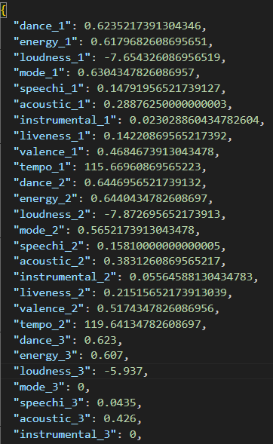
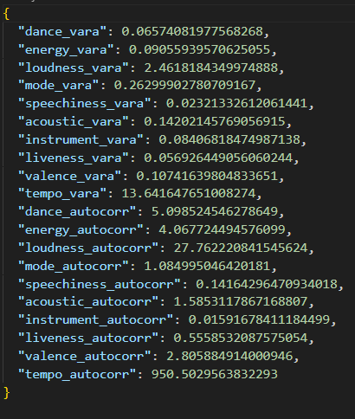

$⇒$
Session wise for Person
For each person variability and inertia was calculated

Slide 20
Low Variability:
Low variability suggests that the scores or values across different sessions are relatively consistent or stable.
In the context of emotions, low variability might suggest that an individual's emotional state remains relatively stable across different sessions or time points.
High Variability:
High variability indicates that the scores or values across different sessions are widely spread out or fluctuate significantly.
In the context of emotions, high variability might indicate that an individual's emotional state fluctuates frequently and is less stable across different sessions or time points.
Low Inertia:
Low inertia, indicated by low autocorrelation coefficient, suggests that there is little predictability or stability in the feature or emotion from one time-point to the next.
In the context of emotions, low inertia might indicate that an individual's emotional state at one time-point does not strongly predict their emotional state at the next time-point.
High Inertia:
High inertia, indicated by high autocorrelation coefficient, suggests that there is strong predictability or stability in the feature or emotion from one time-point to the next
In the context of emotions, high inertia might indicate that an individual's emotional state at one time-point strongly predicts their emotional state at the next time-point.

Slide 21
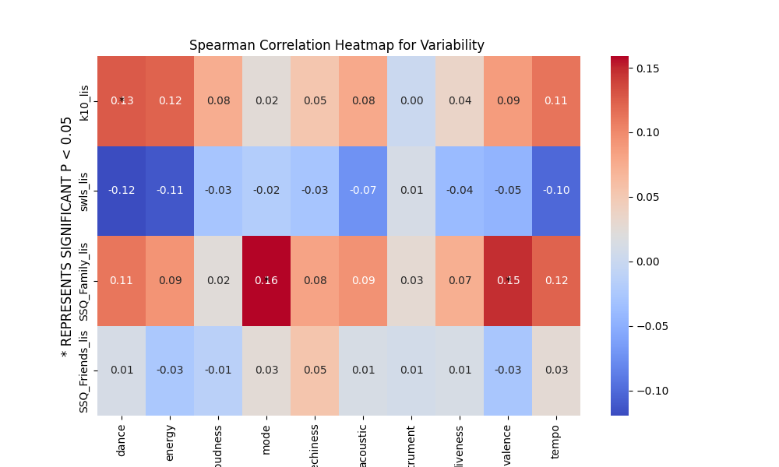

Slide 22
Inference variability
Significant +ve correlation between K10 and danceability
Individuals experiencing higher levels of psychological distress or instability tend to have more varied preferences in the danceability of the music they listen to across different sessions
Significant +ve correlation between SSQ_Family and mode(melodic and harmonic behaviour),valence

Slide 23
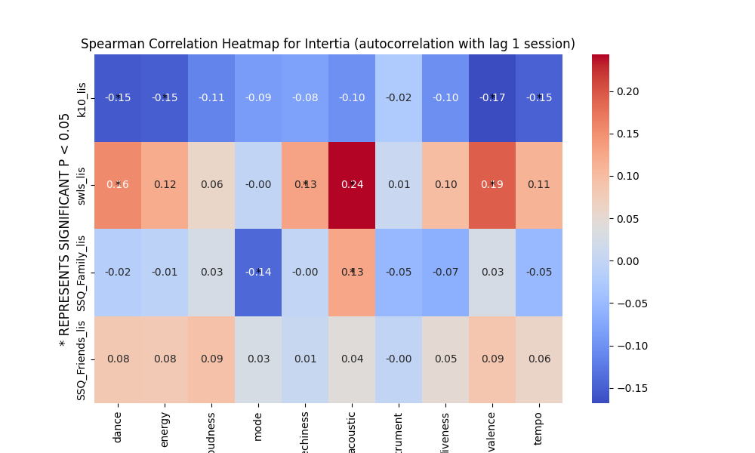

Slide 24
Inference Inertia
Significant -ve correlation between K10 and danceability,energy(arousal),valence***,tempo
Significant +ve correlation between SWLS and danceability,speachiness,acousticness,valence
Significant -ve correlation between SSQ_Family and mode
Significant +ve correlation between SSQ_Family and acousticness

Slide 25
Completed

